Slide 1

LAPTOP PRICES IN INDIA -based on excel sheet
Course : INT217 Project
Registration no : 11906291
Name : Yandamuri kiran
Section : K19AM

Slide 2
Introduction:
Data management is important because the data your organization creates is a very valuable resource.
The last thing you want to do is spend time and resources collecting data and business intelligence, only to lose or misplace that information.
Data Analysis is a process of inspecting, cleansing, transforming, and modeling data with the goal of discovering useful information, informing conclusions
This project is based on such data analysis on LAPTOP PRICES IN INDIA
Laptop prices in india is an database information related to Serial no, Company, Product, Type name, Inches, Screen Resolution, Central processing unit, Ram, Memory, Graphics processing unit, Operating systems, Weight, Price in euros, price in rupees.

Slide 3
Objectives:
Which laptop company is so popular
Total price variations using vlookup
Average price of operating systems in laptop
Top ten laptops which having more inches
Laptops having highest ram

Slide 4
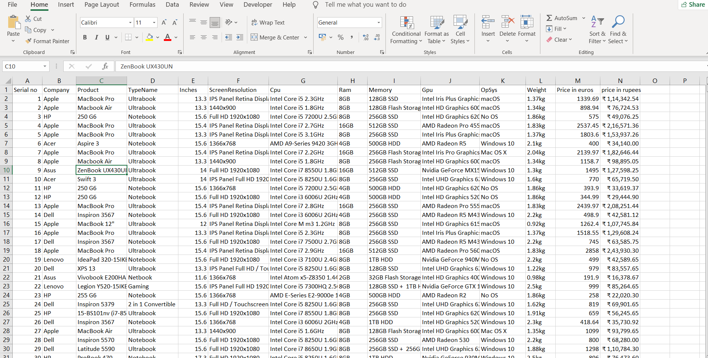
Data set

